Slide 1
Stolen Election
By Jorge Kina and Eric Stones

Slide 2
Voting Systems and Operating Sytems
Voting Systems
Helios Voting System
Evote Voting System
Estonian Voting System
Operating Systems
Ubuntu Linux

Slide 3
Before we started
Find systems to attack
Research the systems to be attacked
Past attacks (if any)
Research possible attacks to be done.
Research tools that could be used for attacking the systems.

Slide 4
Unsuccessful Systems
We tried running the Helios voting system in our own machines but we were not successful.
We tried running the Estonian voting system but all of their documentation was in a different language. This made it difficult for us to continue with this system.

Slide 5
Successful System
We managed to run evote in our own operating system.
Evote voting system was still in beta so it had some coding errors.
The system did not run at first. We had to modify some code to run it and fit what we were doing.
The email system was not working so we had to print the emails into the linux terminal.

Slide 6
Evote
It uses web2py framework for server.
It is written in Python.
It uses RSA for public/private key generation.
The ballots use signatures to check if they have been modified.
Users can use any password (does not have restrictions).

Slide 7
How it Worked
Anyone can make an account. New users are given a unique link to complete registration.
Any manager can start an election, and any user can be a manager. They can customize the ballot that the voters will submit. They enter the e-mails of everyone they want to be able to vote in the election and can enter the emails of anyone they want to be a manager of the election.
Voters are sent an email with a unique token that allows them to vote in the election.
The election closes either by reaching it’s close date or by a manager manually closing it.
Anyone involved in the voting can view the results.

Slide 8
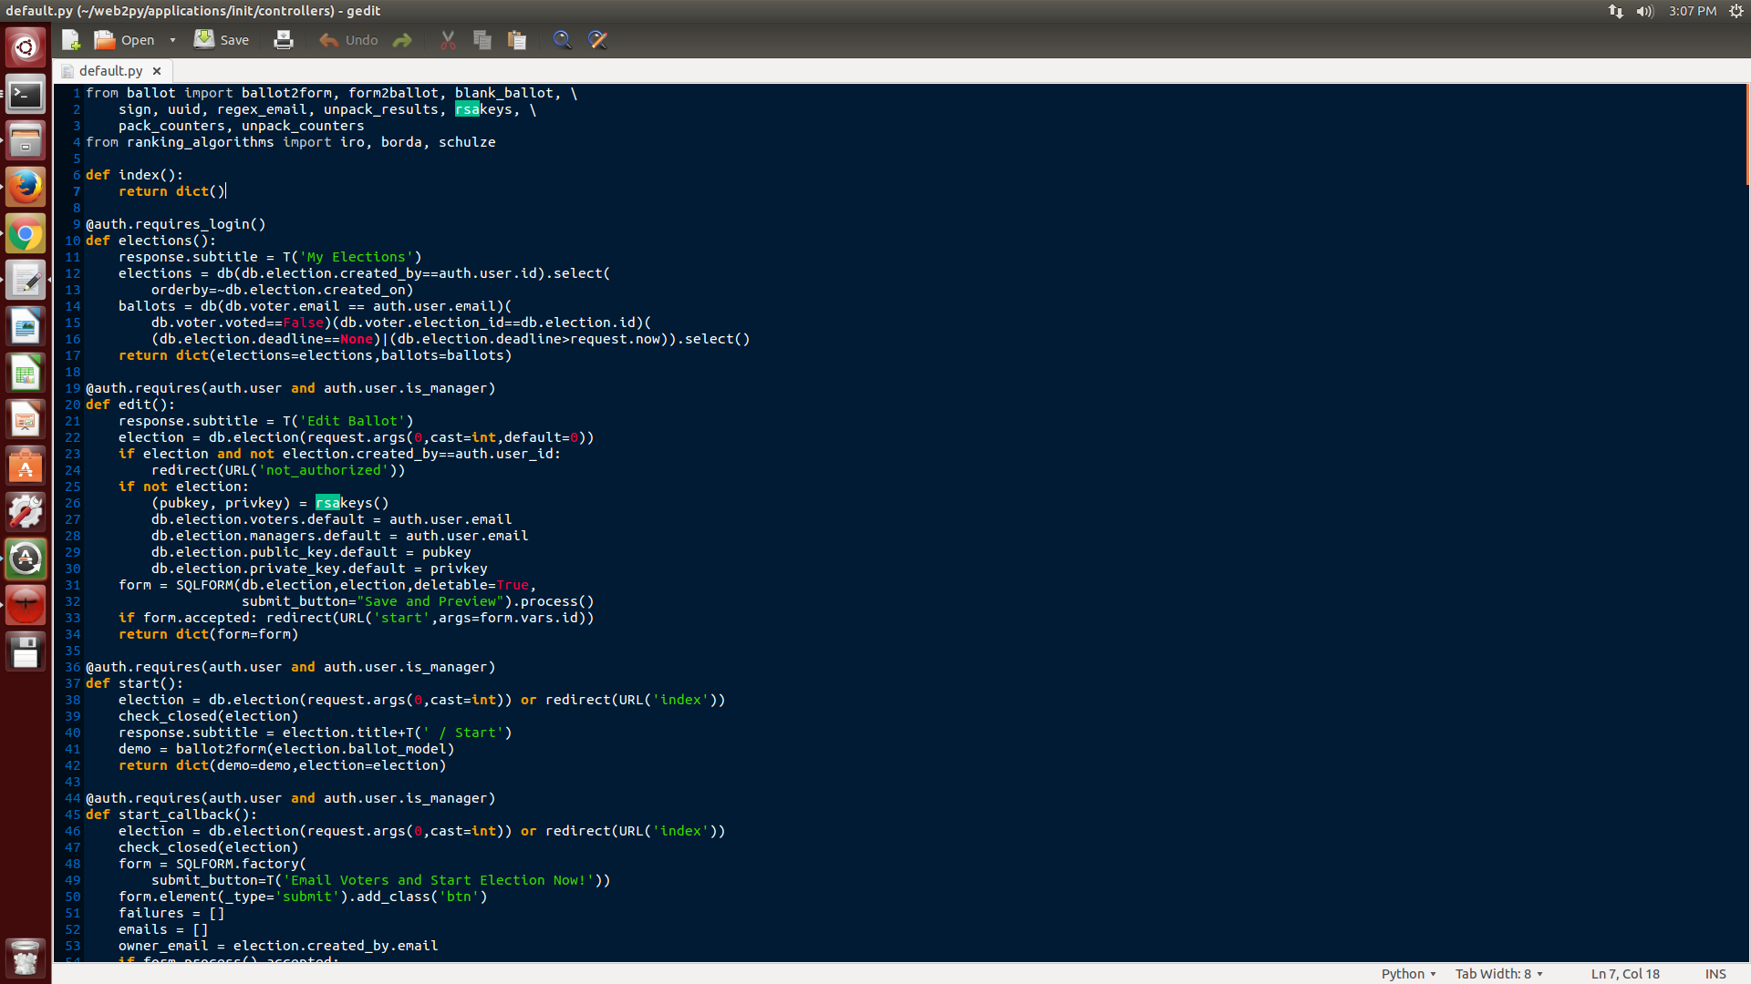
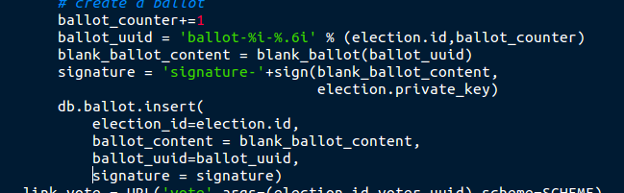

Slide 9
What we need to learn
Learn how to operate in linux
Learn how their code was working
Learn how to use the new tools that we found

Slide 10
Attacks
SQL injection
SQLmap
XSS
manually
XSSer
Port Scanning
Wireshark

Slide 11
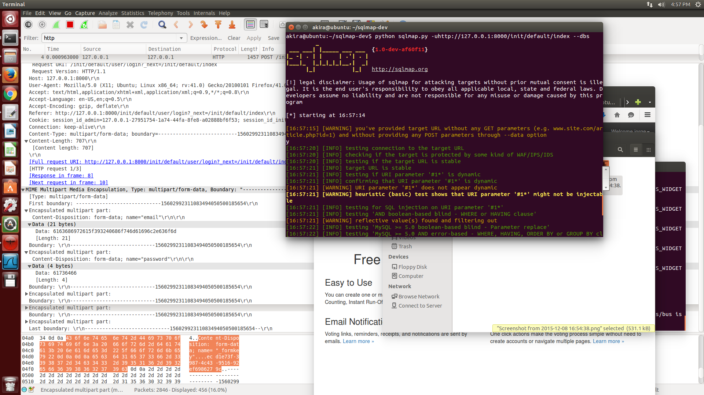
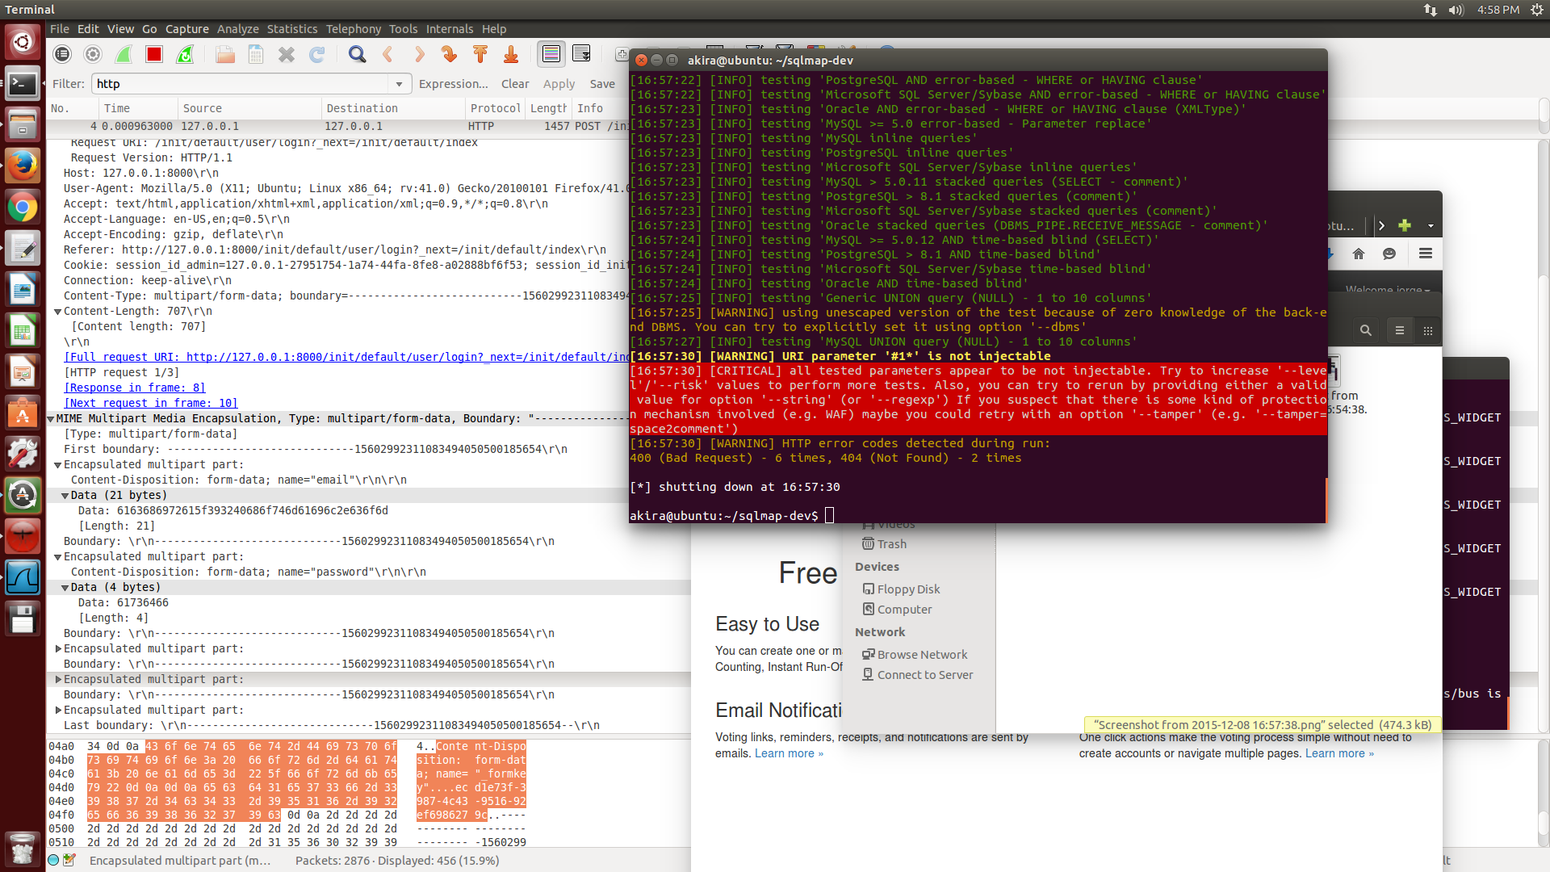
SQL injection
We used a program called SQLmap to check for sql injections
We did not find any openings for sql injections

Slide 12
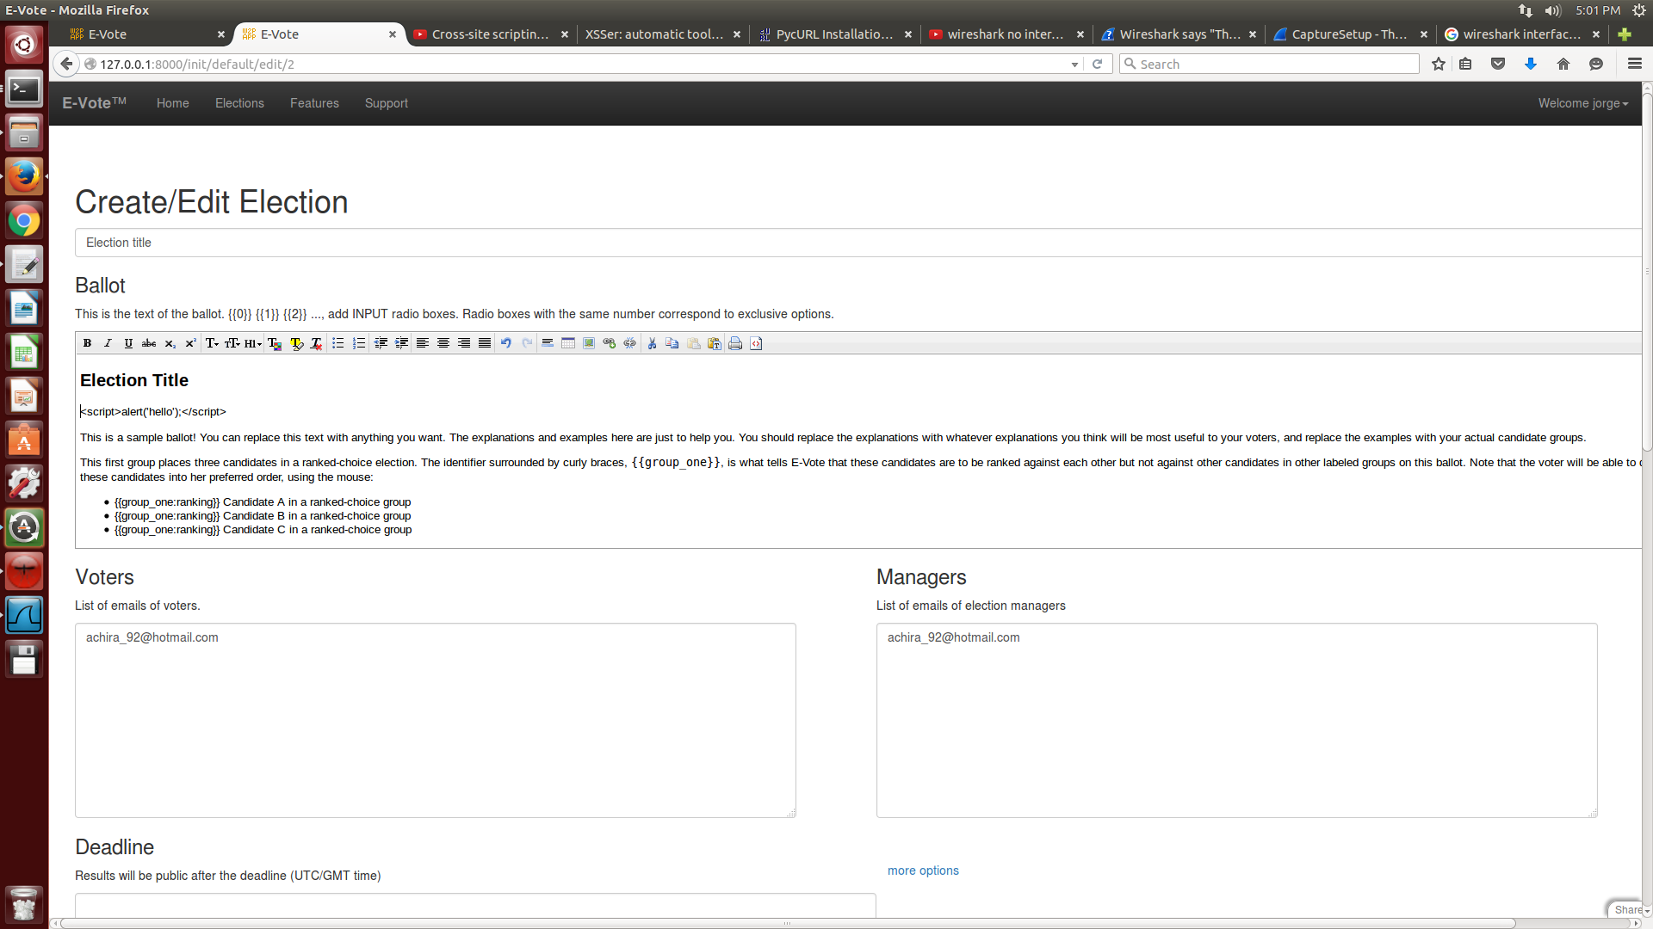
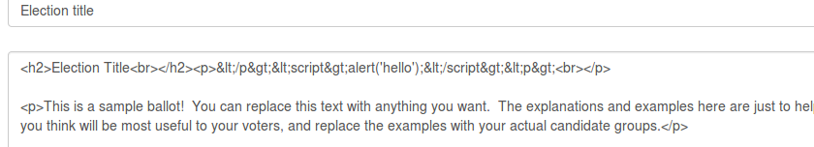
XSS
We tried xss manually but the database checks for special characters

Slide 13
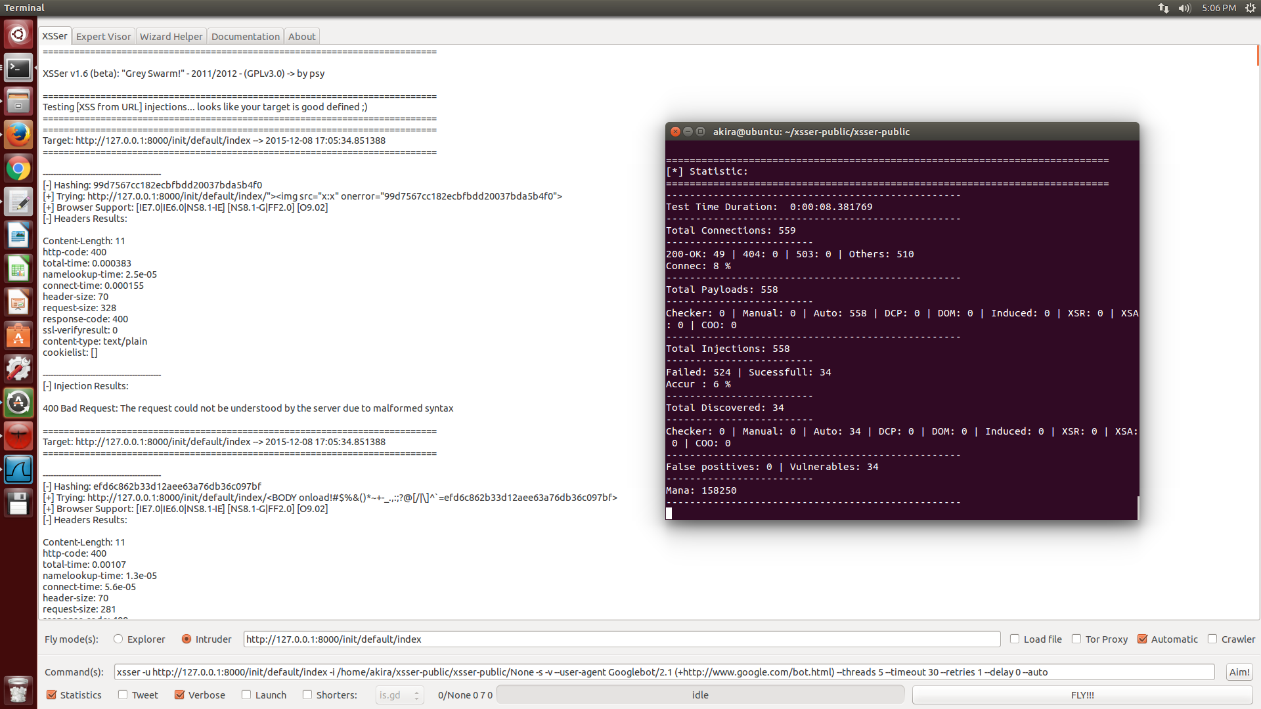
XSSer

Slide 14
Port Scanning
For port scanning we used a program called Wireshark.
Using Wireshark after logging in, we can see the email and password.
They look like they are encoded but they are actually in hexadicimal

Slide 15
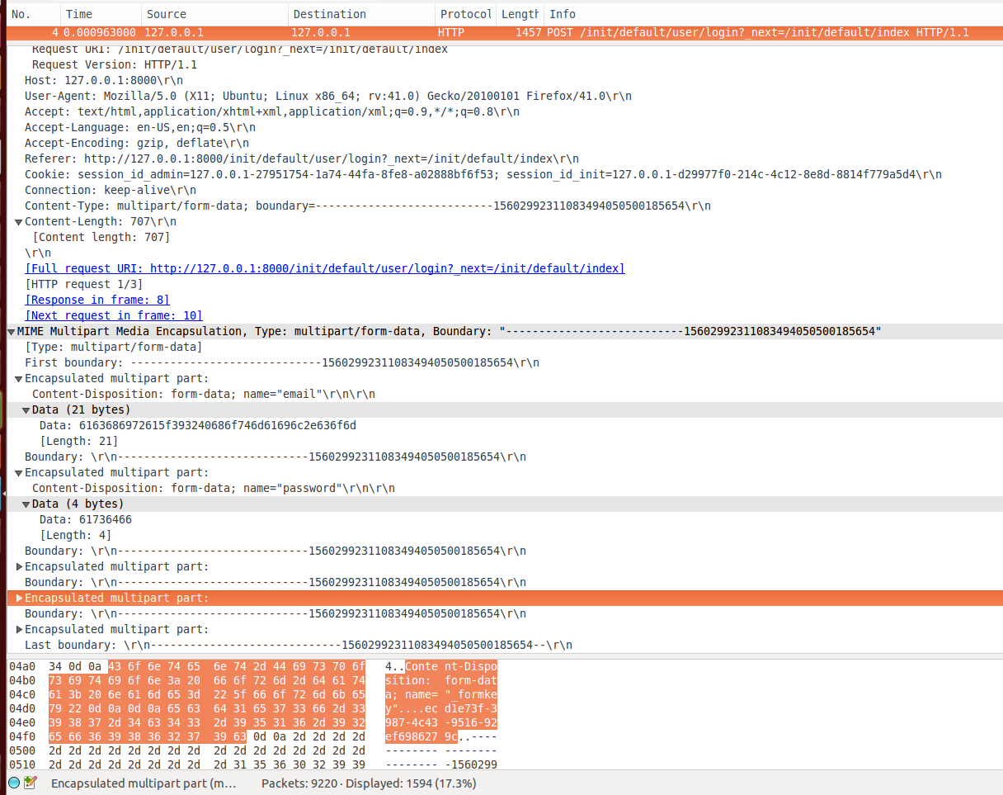

Slide 16
Future
Find new ways to get unwanted access to the voting systems.
Attack the ballots.
Tamper with the keys that allow users to vote.
Try to run the other voting systems.

